Slide 1
FY21 PROJECTED PROFITABILITY ANALYSIS
College of Law,
LOYOLA UNIVERSITY, NEW ORLEANS

Slide 2
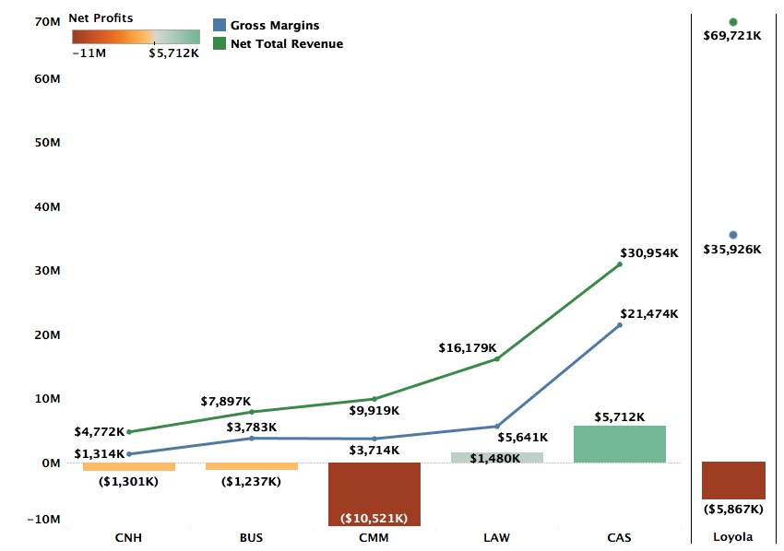
Profitability by College FY21 Projections

Slide 3
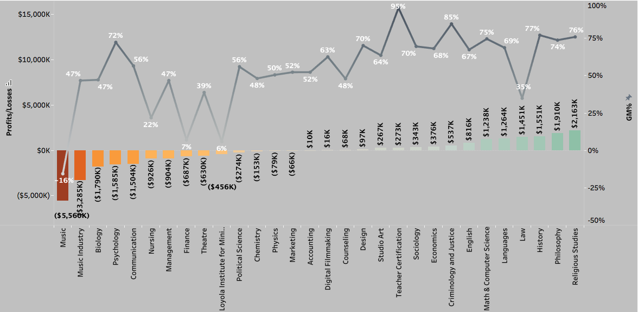
Profitability and GM% by Department (FY21 Projections)
Excluding Environment

Slide 4
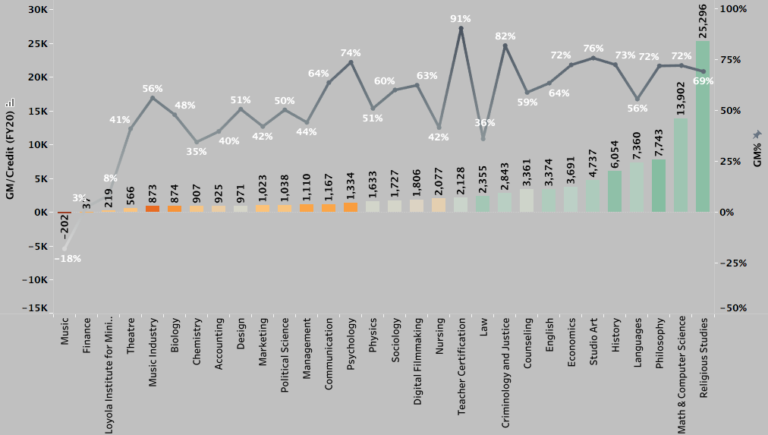
FY20 GM/Credit

Slide 5
DEFINITIONS
Total Revenue (TR): TR includes revenue for courses taught by the faculty of a department across all three terms, distributed revenue for courses that do not belong to a specific department, and distribution of revenues from courses of programs like Study Abroad that do not have any assigned faculty.
Avg. TR per credit (FY20) for Fall and Spring semesters is $577
Gross Margins (GM): GM = TR – Direct Costs. Direct costs include salaries, operating costs, and fringe benefits.
Avg. GM% for FY20 = 54%
Profitability = GM – Indirect Costs + Indirect Revenues. Indirect costs refer to administration costs, auxiliary costs, or college level costs distributed over departments of the specific college. Indirect revenues include auxiliary revenues, dorm revenues, and revenue from other sources.

Slide 6
Methodology FY21 Projections
FY21 Revenue Projections: Revenue projections are based on Fall 2020 enrollments and projected Spring retention rate. FY20 summer revenues are used as proxy for the FY21 summer term.
Direct Costs: Direct costs include salaries and operating costs from department budgets. FY20 fringe benefits are used as a proxy for FY21 fringe benefits.
Indirect Costs: Indirect costs in FY20 and FY21 have been higher than previous years and is reflected in department-level profitability. FY21 is also estimated to bring in lower Auxiliary revenues.

Slide 7
Appendix (FY19 and FY20)

Slide 8
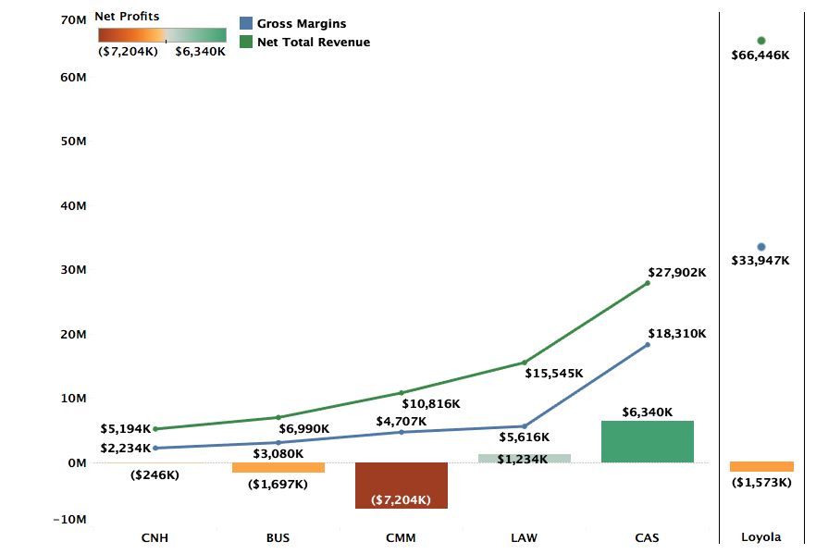
Profitability by College FY20 Actuals

Slide 9
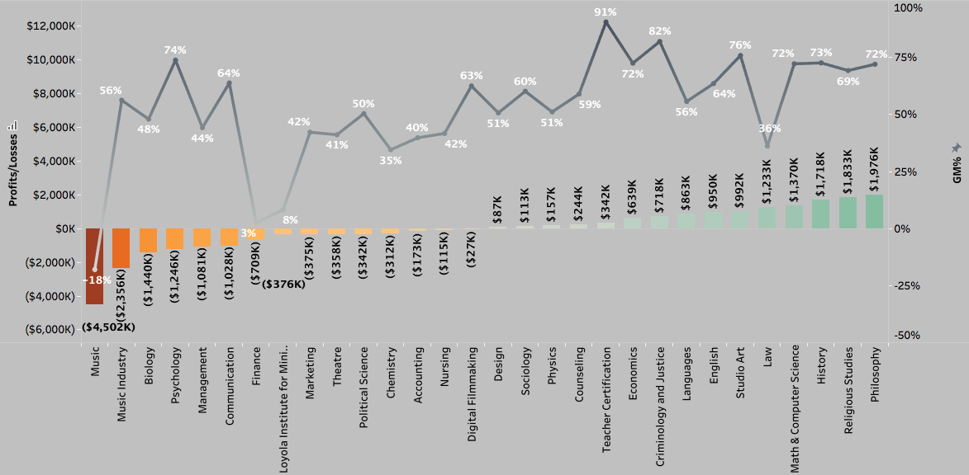
Profitability and GM% by Department (FY20 Actuals)
Notes:
Accounting is projected to be positive. All other 14 departments continue to be loss making. – Add the note on Accounting

Slide 10
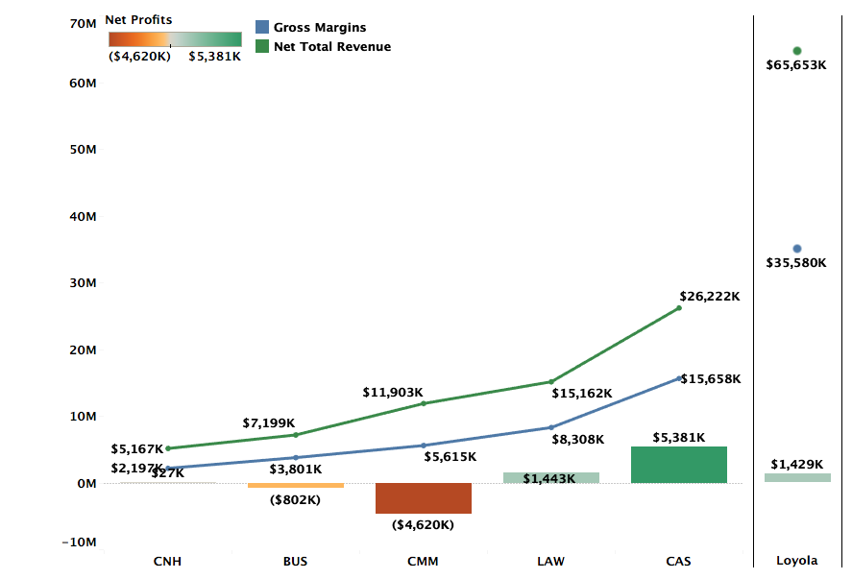
Profitability by College FY19 Actuals

Slide 11
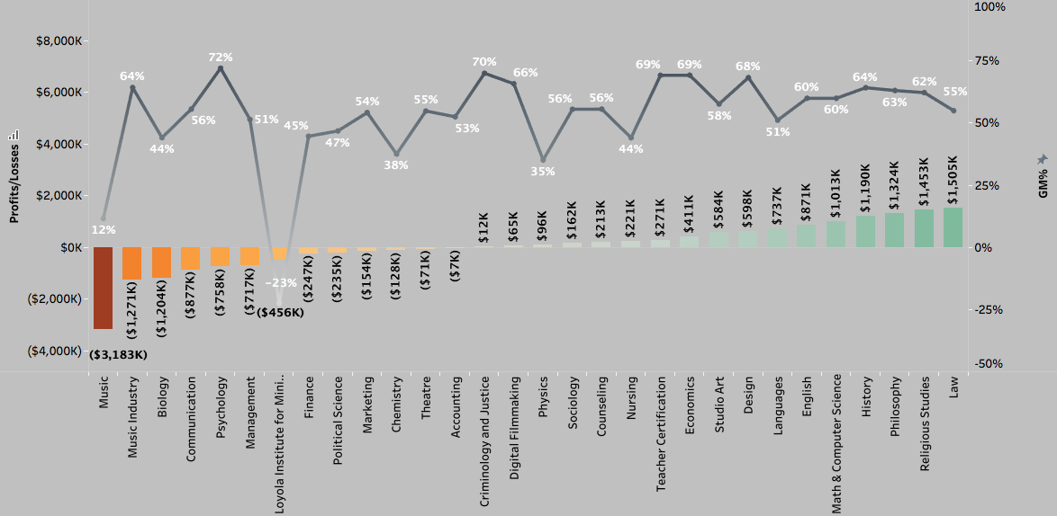
Profitability and GM% by Department (FY19 Actuals)

